Slide 1
GPU-based Global Drone Localization
Jizhou Yan

Slide 2
Outline
Implementation
Find best parameter
Plan

Slide 3
Implementation
Test platform
Tegra K1 SOC
NVIDIA Kepler GPU with 192 CUDA Cores
Quad-Core ARM® Cortex™-A15 CPU
2GB Memory
Performance
SIFT FPS: 21.7
Localization FPS: 16.1
RMSE: 17.4 mm

Slide 4
Implementation
Result on test dataset

Slide 5
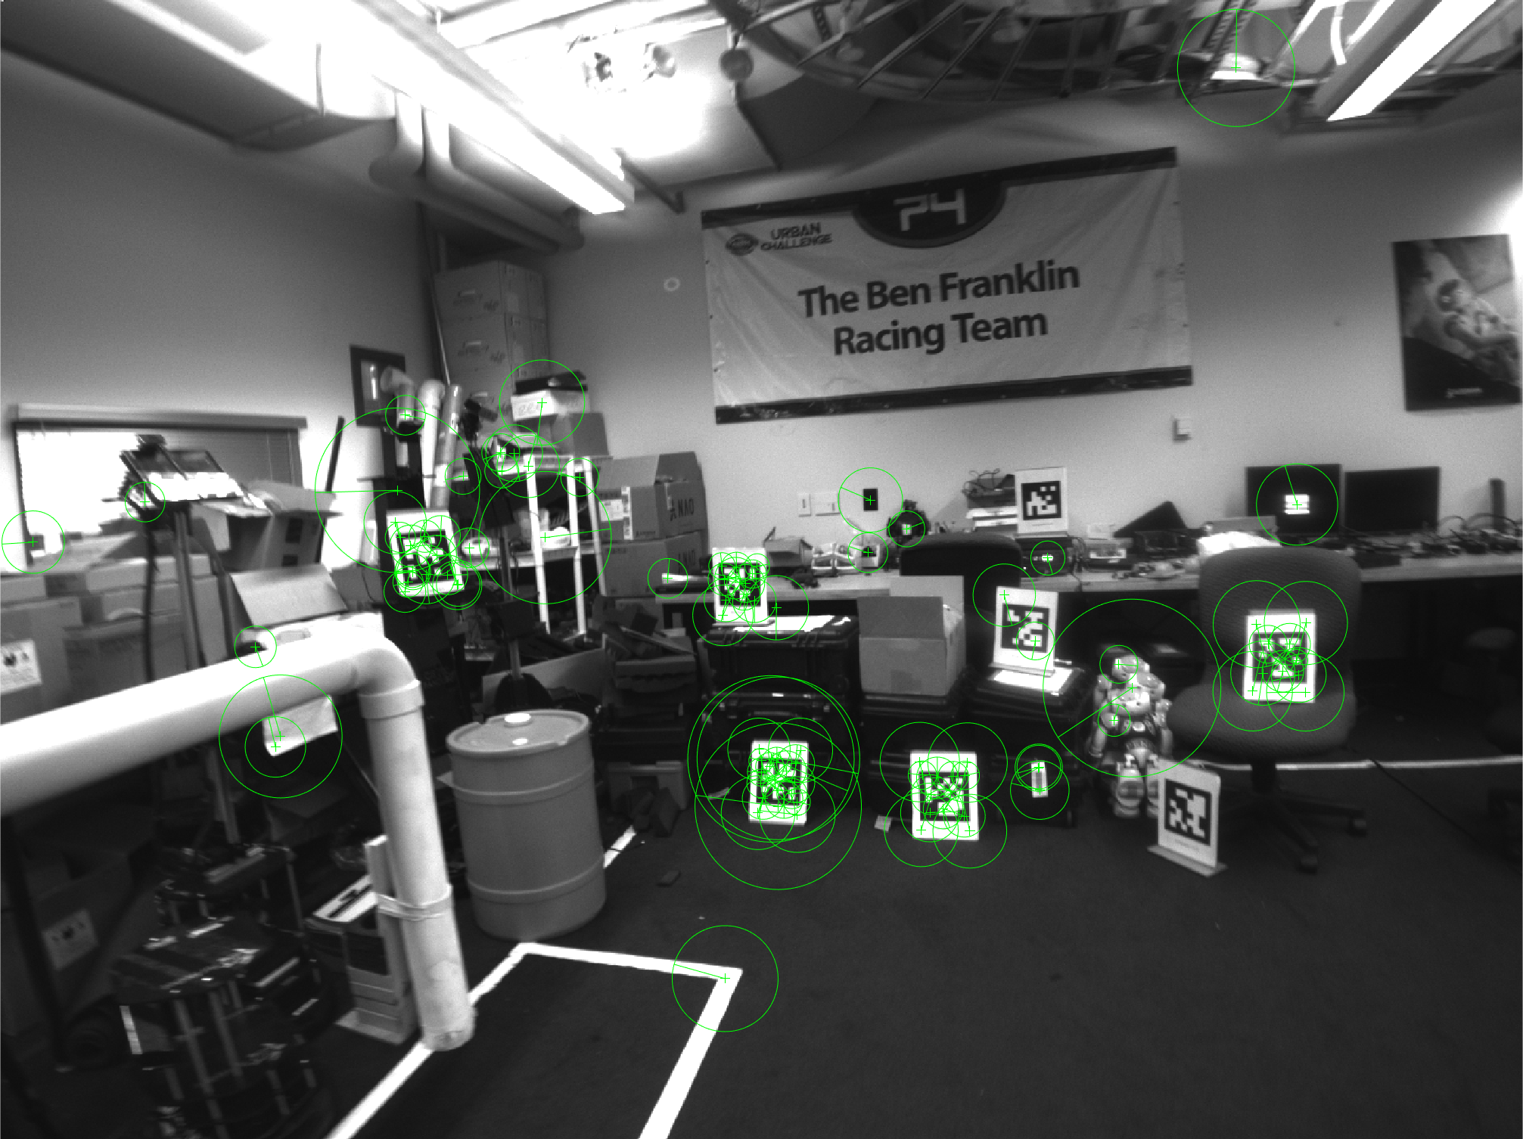
Implementation
Number of feature: 100
Number of Octave layers: 3
Contrast threshold: 0.1
Edge Threshold: 20
Sigma: 1.6
Sub-pixel interpolation: yes

Slide 6
Find best parameter
Number of feature
Number of Octave layers
Contrast threshold
Edge Threshold
Sigma
Sub-pixel interpolation

Slide 7
Find best parameter
Number of feature: 100

Slide 8
Find best parameter
Number of Octave layers: 3

Slide 9
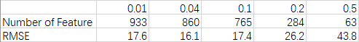
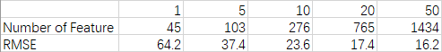
Find best parameter
Contrast threshold: 0.1
Edge Threshold: 20

Slide 10
Plan
Current FPS is not enough
Implement parallel optical-flow
New Frame
SIFT Extraction
Matching
Camera Pose Estimation
Optical-Flow Tracking

